Slide 1

HPE CTY - 22 NIE - HPE
Group - 3
Project Title: Jupyter Notebook Examples for iLO Rest
HPE Mentor: Kallur, Rajeevalochana
NIE Mentor: Shashank Dhananjaya
Team Members: Aditya Pratap Singh, Harshith V, Navaneeth S, R Nagaratna

Slide 2
iLO Rest
HPE Integrated Lights Out (iLO) server management provides intelligent remote control automation through scripting or an API.
Gain even more capabilities that go beyond scripting by leveraging one API to manage your complete lifecycle of HPE Gen9 and Gen10 servers.
A single API interface integrates server management components and full compute power.
Use it with HPE iLO 4 and iLO 5 to perform remote server provisioning, configuration, inventory and monitoring to industry standards through Redfish API conformance.
The Python library provides a rich Python library for developers to easy interact with the iLO RESTful API.
The PowerShell library provides comments to interact with Windows PowerShell Interface to the iLO RESTful API.
The Ruby library enables to interact the iLO RESTful API.
The JavaScript library enables Java developers to easily integrate with the iLO RESTful API.

Slide 3
Redfish API
Redfish is a network standard for the management of servers, networks, storage devices, and other converged infrastructure (CI) components in software-defined hybrid IT environments like web-scale data centers and cloud infrastructure.
Redfish is a hypermedia API. The term hypermedia refers to its capability to manage multimedia like text, audio, video, graphics, and hyperlinks, making it well suited for media-rich systems and storage systems.
Redfish was designed to reduce overhead, increase system administrators’ productivity, it allows a device to be virtually reallocated to a different client without someone having to physically be at the data center.
Redfish is not limited to component management. It is also used to manage data center infrastructure management (DCIM), power and cooling, it also provides tools and extensions for frameworks like Ansible and Puppet that automate tasks like cloud provisioning and application deployments.
Redfish is schema based and provides a RESTful interface over Hypertext Transfer Protocol (HTTP) using JavaScript Object Notation (JSON) format.

Slide 4
Jupyter Examples Data-flow Design
Power options
Bios settings
Account settings
Other settings
User
iLO
Jupyter Interface
Github.com

Slide 5
Restful Architecture
The Representational State Transfer (REST) architectural style is a worldview that elevates information into a first-class element of architectures.
REST allows us to achieve the architectural properties of performance, scalability, generality, simplicity, modifiability, and extensibility.
Transferring, accessing, and manipulating textual data representations in a stateless manner.
A RESTful API service is exposed through a Uniform Resource Locator (URL).
REST is best used to manage systems by decoupling the information that is produced and consumed from the technologies that produce and consume it.
The main HTTP verbs and their operation which are used by well-designed RESTful systems are:
GET | READ
POST | CREATE
PUT | UPDATE / REPLACE
PATCH | UPDATE / UPDATE
DELETE | REMOVE

Slide 6
Restful Architecture (Cont.)
The CRUD operations involved are:
GET
A GET request is the most common verb on the Web.
GET method is used to retrieve data from the server.
A GET request transfers representations of named resources from a server to a client.
One of the key points about the GET request is that it should not modify anything on the server side.
POST
POST is used to create or update a resource from the client to the server.
When a new resource is Posted to the parent, the API service will automatically associate the new resource by assigning it an ID (new resource URI).
The difference between GET and POST is that POST is used when the client cannot predict the identity of the resource it is requesting to be created.
Another major use of the POST is to append a resource and submit queries.

Slide 7
Restful Architecture (Cont.)
PUT
The PUT method is most often used to update an existing resource.
A client can issue a PUT request to a known URL as a means of passing the representation back to the server in order to do an overwrite action.
If a client is in the process of issuing a PUT overwrite and it is interrupted, it can feel empowered to issue it again because an overwrite action can be reissued with no consequences; the client is attempting to control the state, so it can simply reissue the command.
PUT can also be used to create a resource if the client is able to predict the resource’s identity.
PUT requests are idempotent.
PATCH
The PATCH method is very similar to the PUT method because it also modifies an existing resource.
A PATCH request in a standard format allows an interaction to be more explicit about the intent.
The difference is that for the PUT method, the request body contains the complete new version, whereas for the PATCH method, the request body only needs to contain the specific changes to the resource.
DELETE
The DELETE method is used to delete a resource specified by its URL.
DELETE operation is idempotent which means that if you DELETE a resource, then it is removed, gone forever

Slide 8
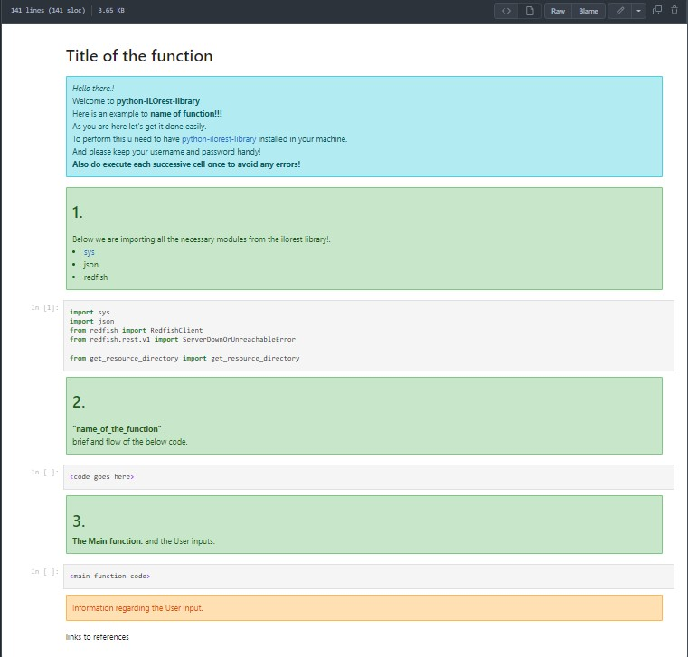
Jupyter Notebook Design

Slide 9
THANK YOU

